Slide 1

Seasonal Agriculture Performance Analysis
Siddhi Mahesh Chavan
Yashaswi Education Society’s, International Institute of Management and Science, Pune
AICTE STU ID :STU673754138b1451731679251

Slide 2

PROBLEM STATEMENT
Agricultural performance is influenced by seasonal environmental conditions, farming practices, resource availability and market conditions. This project analyzes the supplied agricultural dataset to identify seasonal differences in yield, production, resource use, risk and economic performance, and to derive evidence-based planning insights.

Slide 3
Project Description
The project analyzes 4,000 agricultural records across 3 seasons, 8 states, 8 crops and 4 irrigation methods. The workflow covers data inspection, missing-value treatment, exploratory analysis, seasonal comparison, crop-season analysis, irrigation/resource analysis, regional comparison, statistical testing and evidence-based recommendations.

Slide 4

WHO ARE THE END USERS?
• Farmers and farm managers – seasonal crop and resource planning
• Agricultural analysts – performance and trend analysis
• Agricultural planners/policymakers – regional and seasonal planning
• Agri-businesses – production and market strategy
• Resource managers – water and input-use assessment

Slide 5

Technology Used
• Python
• Pandas and NumPy – data cleaning and analysis
• Matplotlib – data visualization
• SciPy – statistical testing
• Jupyter Notebook – analysis documentation
• PowerPoint – project presentation

Slide 6
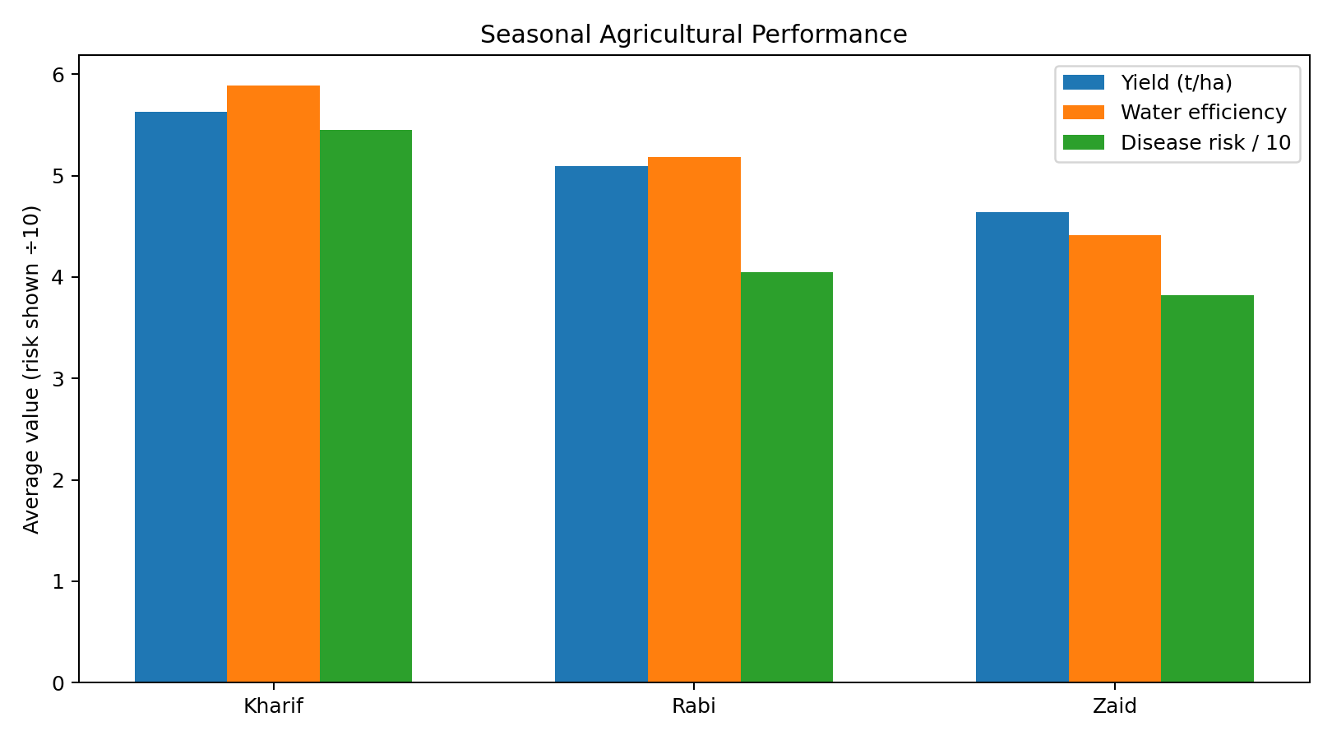
RESULTS
Dataset: 4,000 rows × 28 columns
Seasons: Kharif 1,779 | Rabi 1,627 | Zaid 594
Missing values handled: Rainfall 48, Soil Moisture 40, Yield 32
Best overall season: Kharif
Avg yield: 5.63 t/ha
Avg profit: ₹178,915
Profitable farms: 57.79%

Slide 7
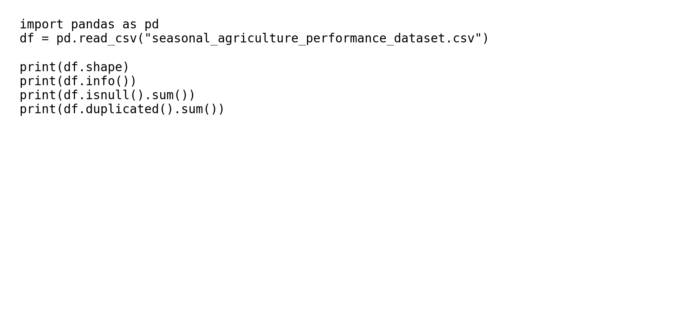
RESULTS – Data Preparation
Data quality findings
• 4,000 observations and 28 variables
• 0 duplicate rows
• No negative values in core numeric measures
• Missing values occurred in 3 variables
• Imputation preserved seasonal/crop context

Slide 8
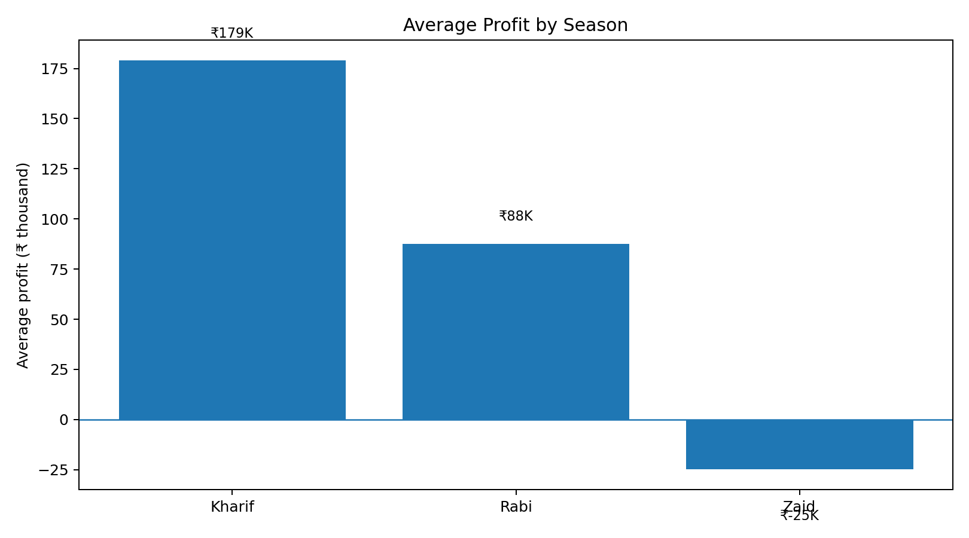
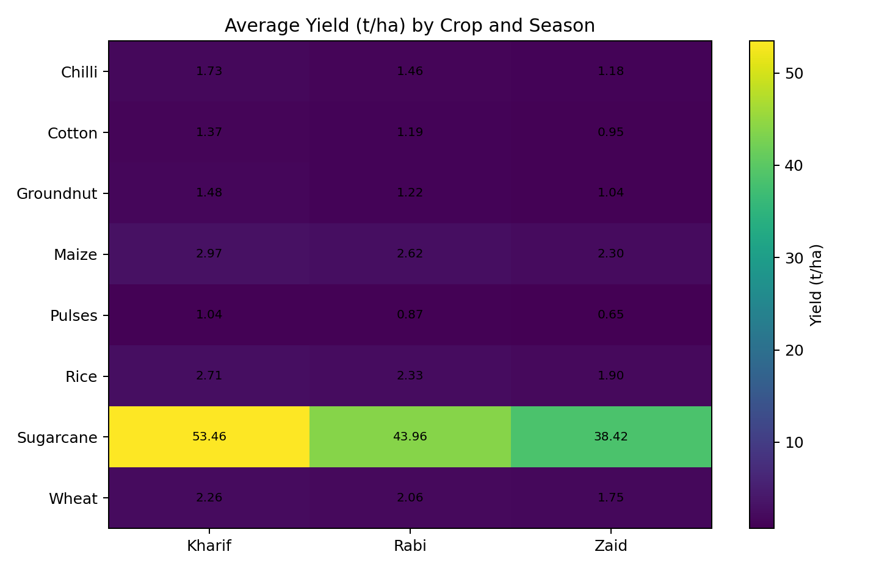
RESULTS – Seasonal & Crop Analysis
Kharif leads overall profitability; Sugarcane and Chilli are the strongest economic performers.

Slide 9
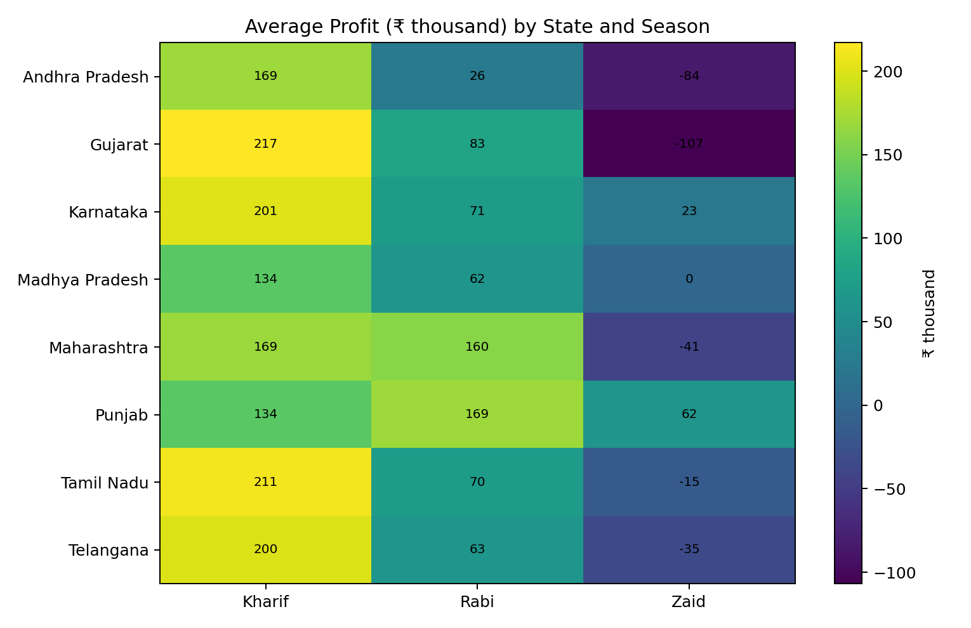
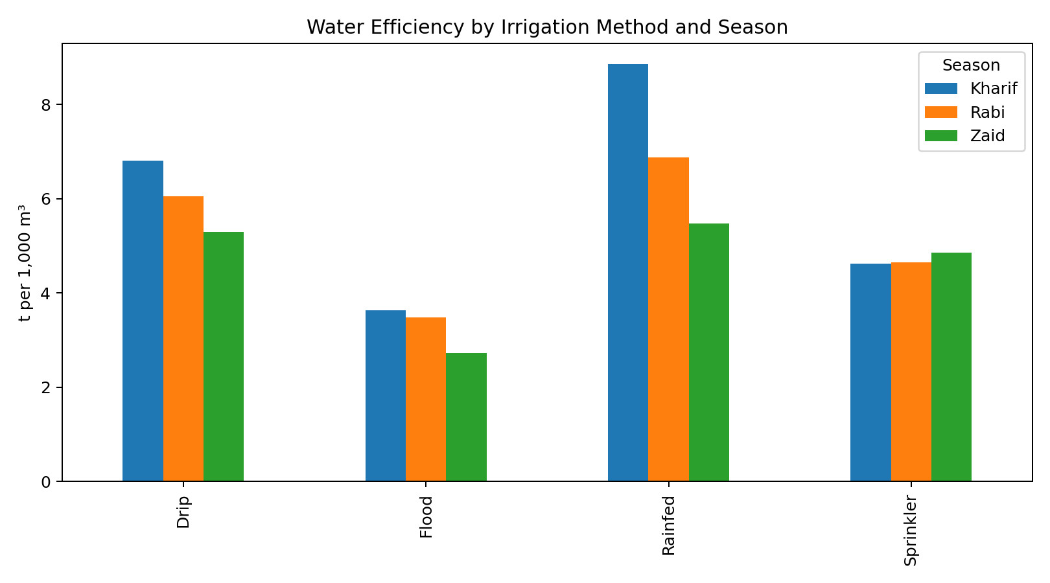
RESULTS – Resources & Regional Analysis
Drip performs strongly for yield in Kharif/Rabi; regional results show that seasonal strategies should be localized.

Slide 10
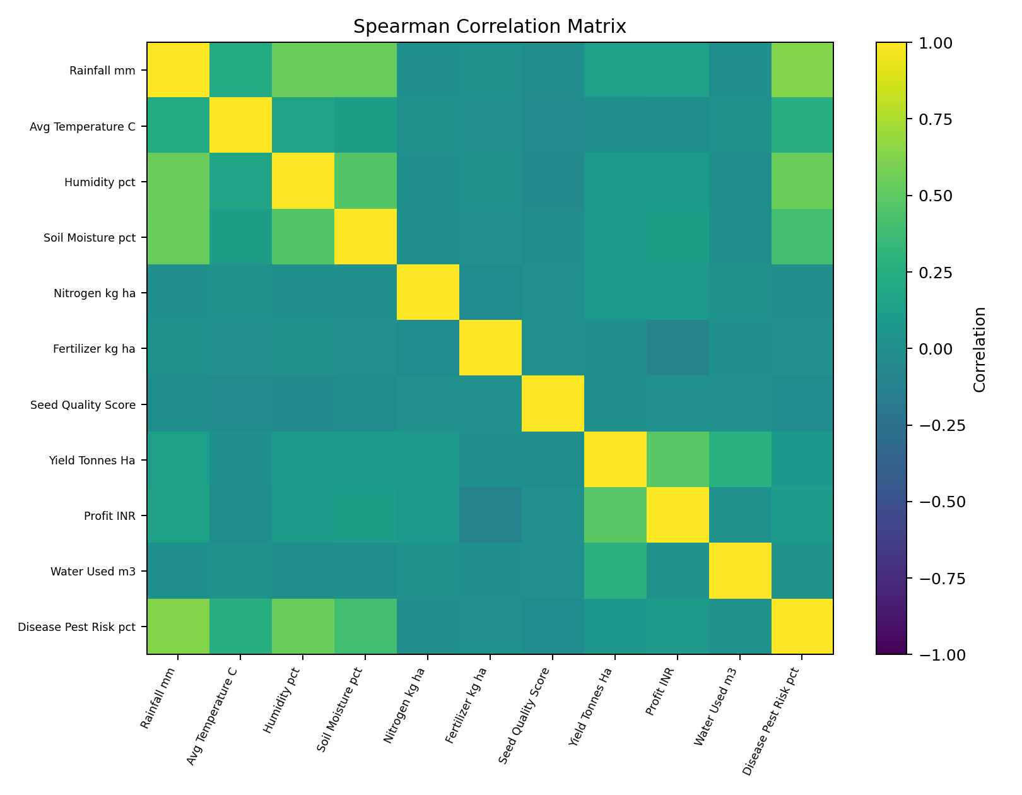
RESULTS – Statistical Findings & Recommendations
Statistical evidence
• Kruskal–Wallis: season differences are significant for yield, profit, water efficiency and disease risk (all p < 0.001).
• Chi-square: profitability status is associated with season (p < 0.001).
Recommendations
• Prioritize Kharif where feasible
• Evaluate crop-season combinations
• Monitor Zaid economics
• Use irrigation strategically
• Integrate pest/climate monitoring

Slide 11
Future scope
• Develop predictive models for yield and profit
• Add multi-year historical data
• Incorporate market-price and input-cost forecasts
• Build an interactive farmer/planner dashboard
• Simulate rainfall and irrigation scenarios
• Integrate satellite, soil and weather data

Slide 12
GitHub Link
GitHub Link
https://github.com/siddhichavan0105-svg/seasonal-agriculture-performance-analysis

Slide 13

VOIS Course completion certificate -
Course name- Data Visualization
VOIS Course completion certificate
Course: Data Visualization

Slide 14
Thank you
.
.

